Slide 1

SHIELD INSURANCE
This presentation will provide a demo of our tool and showcase its various features.

Slide 2

How to Navigate the Dashboard
Home Page:
Features 3 icons for navigation:
General View – Overall Performance
Sales Mode Analysis – Performance by channel
Age-Group Analysis – Insights by Age-Group
Click any icon to go to that page.
Report Pages:
Use slicers (Month, Policy, City, Age Group, Sales Mode) to filter visuals.
Click the Home Icon to return anytime.
Next slide shows a live demo of this navigation in action.

Slide 3


Slide 4
Using Filters in the Dashboard
The left filter pane is available on all analytical pages. It includes:
Customer / Revenue Toggle (Switch between Customers and Revenue using the first filter. All visuals update dynamically across all pages.
Age Group
Month (Nov to Apr)
City
Policy ID
Sales Mode
Selecting filters updates visuals across all pages dynamically.
A “clear all filters” icon is located near the filter title — click it to reset the dashboard to default view.
Pane also includes the company logo at the top and abbreviations at the bottom for user reference.
Next slide: Live demo on using these filters effectively.

Slide 5
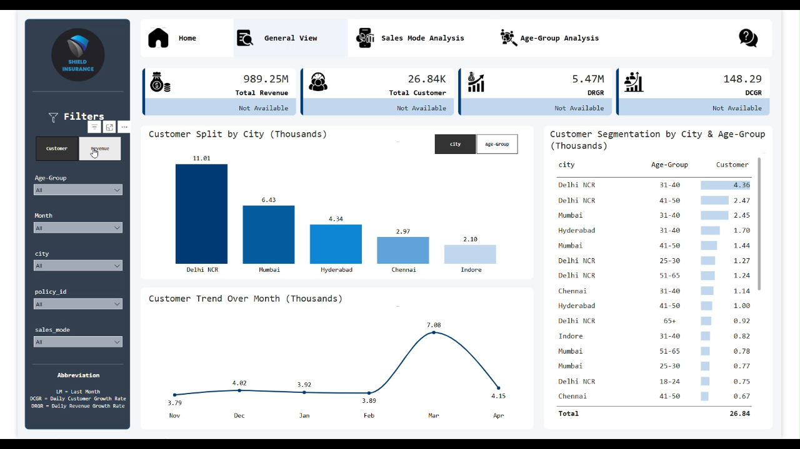

Slide 6
Understanding KPIs in the Dashboard
All pages display these 4 KPIs below the navigation bar:
Total Revenue
Total Customers
DRGR (Daily Revenue Growth Rate)
DCGR (Daily Customer Growth Rate)
When a month is selected, KPIs show:
Current & previous month values
% growth or decline
Color-coded icons & accent bars
Visual cues:
🟢 Green ↑ = Growth 🔴 Red ↓ = Drop ⚫ Black icon & neutral bar = No comparison available
KPI abbreviations are shown in the left filter pane:
LM (Last Month), DRGR (Daily Revenue Growth Rate), DCGR (Daily Customer Growth Rate)
Next slide: Watch a live demo of KPI behavior.

Slide 7
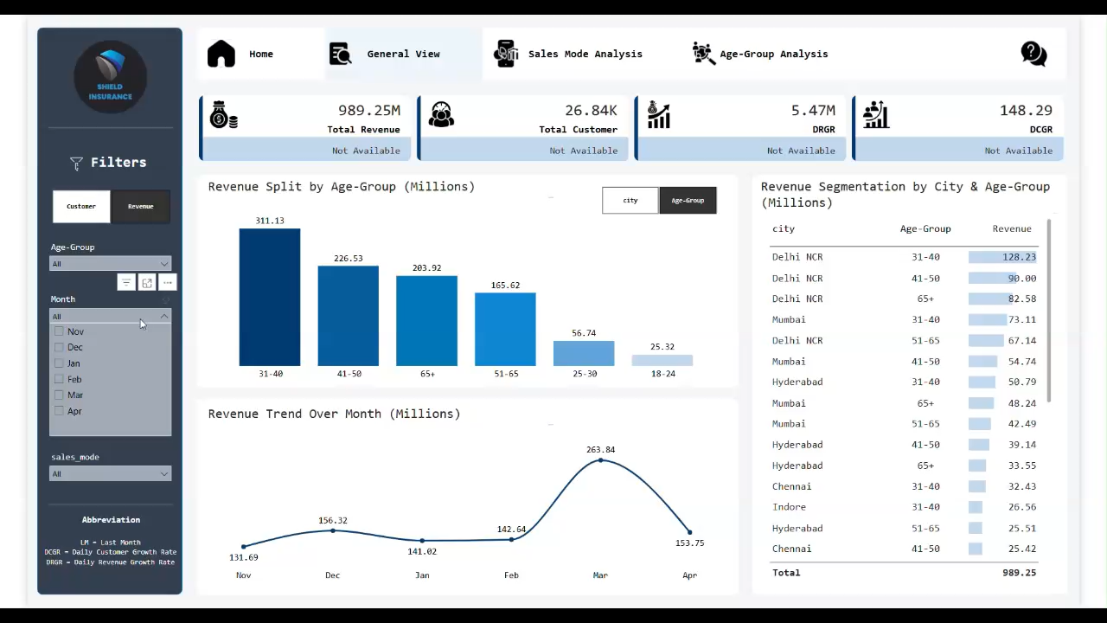

Slide 8
Page Walkthrough – General View
Purpose To analyze revenue trends and customer distribution by city, age group & month.
Key Visuals
Revenue/Customer by City/Age-Group
Monthly Revenue Trend
Revenue/Customer segmentation by Age Group & City
How to Use It
Use the left panel filters to select Age Group, Month, City, Policy ID, or Sales Mode.
Use the Revenue/Customer toggle to update all visuals across the page.
Hover over visuals to view exact values (e.g., ₹401.57M or 4.36K customers).
Note:
Revenue is shown in millions, customers in thousands across all pages.
Toggle near the column visual allows switching between City and Age Group view.
Next slide: Watch a live demo of how to explore this page interactively.

Slide 9
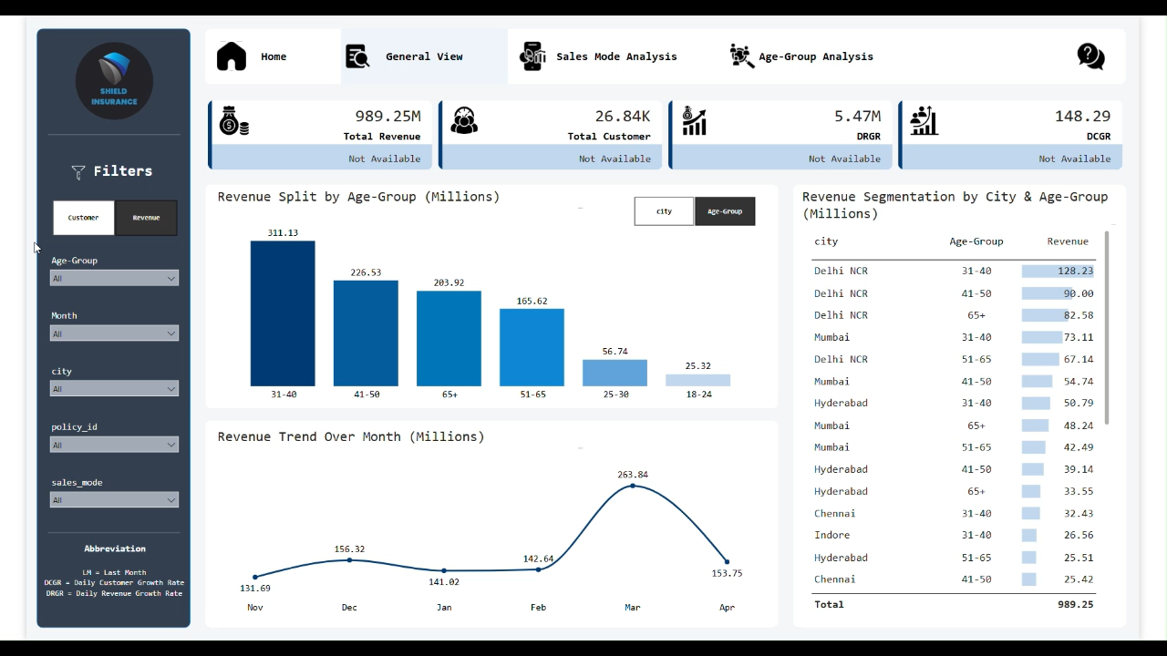

Slide 10
Page Walkthrough – Sales Mode Analysis
Purpose Evaluate performance across sales channels by tracking revenue and customer distribution over time and across age groups.
Key Visuals
Revenue/Customer Split % by Sales Mode
Monthly Trend by Sales Mode
Sales Mode vs Age Group Visual
Includes a toggle button to switch:
Y-axis as Sales Mode (bars split by Age Group)
OR Y-axis as Age Group (bars split by Sales Mode)
How to Use It
Use the Revenue/Customer toggle to update all visuals.
Filter by Age Group, Month, City, or Policy ID.
Use the button below the third visual to switch between sales mode–focused or age group–focused view.
Hover over bars to view exact values and compare performance across segments.
Next slide: Watch a live demo of how to explore this page interactively.

Slide 11
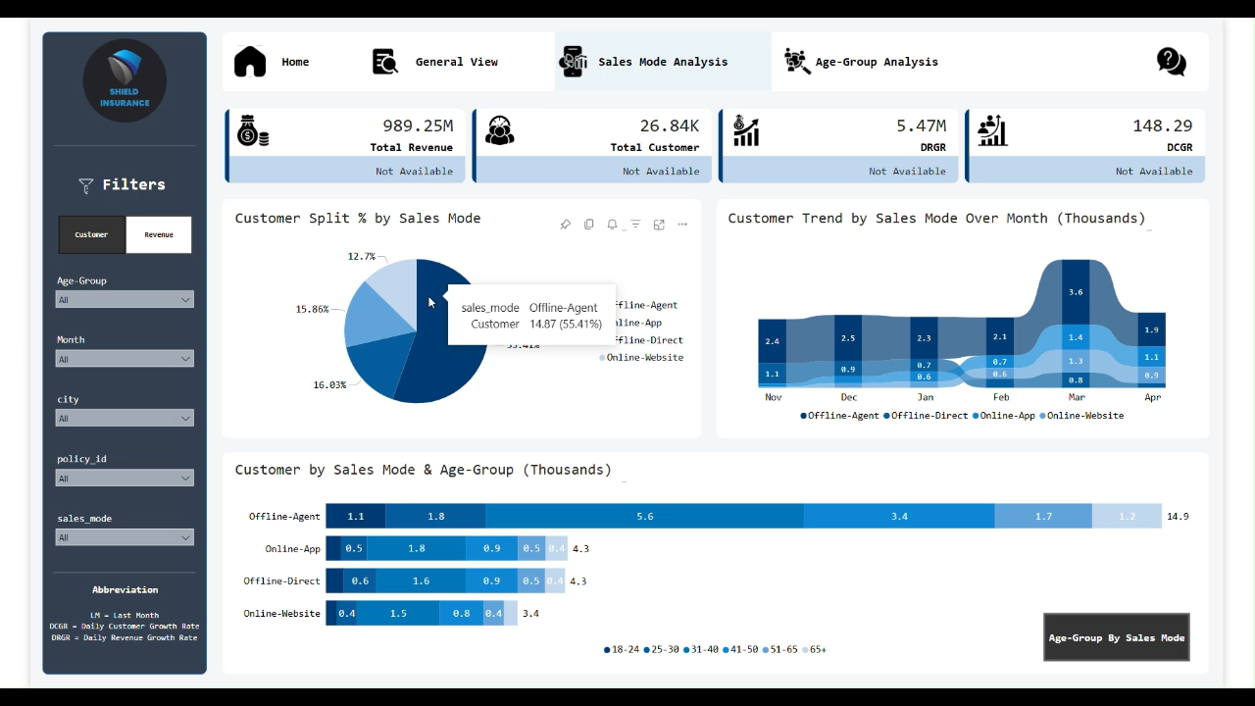

Slide 12
Page Walkthrough – Age Group Analysis
Purpose Understand how different age groups engage with policies, contribute to revenue, and vary in settlement expectations.
Key Visuals
Age Group vs Policy Preference
Monthly Trend by Age Group
Average Settlement Amount by Age Group
How to Use It
Use the Revenue/Customer toggle to switch the metric across all visuals.
Apply filters like Month, City, Sales Mode, and Policy ID to explore specific age-group behavior.
Compare how policy choices and claim settlements differ by age segment.
Hover to view exact revenue (in millions) or customer count (in thousands).
Next slide: Watch a live demo of how to explore this page interactively.

Slide 13
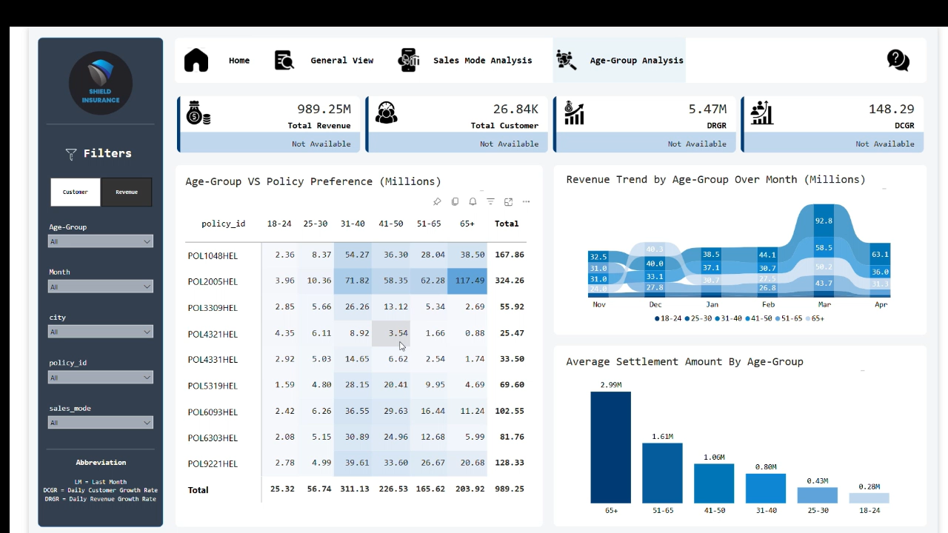

Slide 14
Key Business Questions Answered
Which age groups contribute the most to revenue and customer count? → Answered through Age Group Analysis with policy preferences and trends.
Which sales channels are driving the highest performance? → Sales Mode Analysis shows revenue/customer share and trend by mode.
What are the best-performing and underperforming policies? → Policy-level views reveal revenue and customer volume by age group.
How are revenue and customer numbers trending month over month? → General View and KPI section track monthly changes with growth indicators.
Which cities bring the most business to Shield Insurance? → City-wise segmentation in the General View highlights regional performance.
Are we retaining or losing customers? → Daily Customer Growth Rate (DCGR) and monthly customer trends offer insight.
How do different age groups affect settlement expectations? → Average Settlement Amount by Age Group chart offers a claims perspective.

Slide 15
Best Practices for Using the Dashboard
Use the Customer/Revenue toggle first Set the focus metric to update all visuals accordingly.
Apply filters one at a time For clearer insights, filter by month, age group, sales mode, city, or policy individually or in combination.
Hover to reveal details Most charts are interactive—hover to view exact values and breakdowns.
Compare trends month-over-month Use KPI growth indicators and monthly trend visuals for performance tracking.
Utilize page-specific switches Some visuals allow toggling (e.g., City vs Age Group, Sales Mode vs Age Group) for alternate perspectives.
Use ‘Clear Filters’ icon when needed Quickly reset your view using the icon near the top of the filter pane.
Refer to KPI abbreviations Find definitions like DRGR, DCGR, and LM in the filter pane for clarity.

Slide 16
THANK YOU
Thank you for taking the time to explore the Shield Insurance Dashboard.
I hope this walkthrough helps you make data-driven decisions with confidence.
Feel free to explore the dashboard and uncover your own insights!

